Slide 1

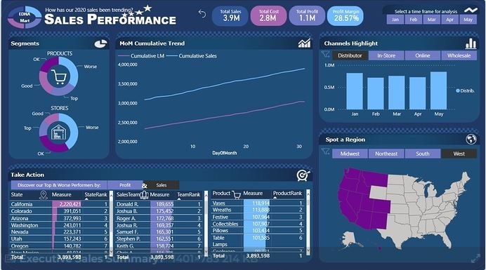
How has our 2020 sales been trending?
EDNA
Mart
SALES PERFORMANCE

Slide 2









